Slide 1

NOVA’s Clery Training

Slide 2
The Clery Law
Crime Awareness & Campus Security Act (Clery Act)
  Contained in section 485 of the Higher Education Act, codified at 20 U.S.C. § 1092.
Campus safety is a vital concern to NOVA.
  1965 - Higher Education Act of 1965 (HEA) – Lyndon Johnson created financial assistance programs
  1990- Congress enacted the Crime Awareness and Campus Security Act of 1990 (Title II of Public Law 101-542), which amended the Higher Education Act of 1965 (HEA).
    Act requires all postsecondary institutions participating in HEA’s Title IV student financial assistance programs to disclose campus crime statistics and security information. Several Amendments have since been made- 1992, 1998, and 2000
  1998 - Amendments renamed the law the Jeanne Clery Disclosure of Campus Security Policy and Campus Crime Statistics Act in memory of a student who was slain in her dorm room in 1986. It is generally referred to as the Clery Act
  2008 – Higher Education Opportunity Act or HEOA (Public Law 110-315) reauthorized and expanded the HEA Act of 1965
    HEOA amended the Clery Act and created additional safety-and security-related requirements for institutions.
NOVA police and the Office of Emergency Preparedness and Safety work together to ensure compliance of the Clery Act for the safety of NOVA’s students, faculty and staff and community
Notes:
1965 - President Lyndon Johnson thought that college was no longer a privilege, but had become a necessity. With this thought in mind, on November 8, 1965 he signed the Higher Education Act which provided numerous federal financial aid programs and assistance to students pursuing higher education, to include less-advantaged student and students pursing international education and professional degrees.
2008 – Additional safety requirements such as Emergency Notifications and Timely Warnings

Slide 3

Jeanne Ann Clery’s Legacy
Raped & murdered April 5, 1986 in her residence hall at Lehigh University in Bethlehem, PA
  Fellow student she didn’t know
History of violent crime on campus
  37 violent crimes in 3 years
Led to national awareness of campus crime
Federal Clery Act (1990)
Notes:
Freshman Spring Semester
181 automatic locking doors were propped open
Offender came in through a propped door for anticipation of her roommate’s return
Found that crime stats were severely under reported by the college
37 violent crimes in the past 3 years on the campus

Slide 4
Reportable Clery Crime Categories
Murder and Non-Negligent Manslaughter
Negligent Manslaughter
Sex Offenses (Rape, Statutory Rape, Incent, Sexual Battery)
Robbery (Armed or strong arm)
Aggravated Assault
Burglary (Forcible Entry, Unlawful Entry, Attempted Forcible Entry)
Motor Vehicle Theft
Hazing
Domestic Violence
Stalking
Arson
Hate Crimes (Bias categories: Religion, Sexual Orientation, Gender, Gender Identity, Ethnicity, National Origin, and/or Disability)
Liquor Law Violations (Doe not include Drunk in Public cases)
Drug Law Violations
Weapons Law Violations
The following link will bring you to NOVA’s webpage that explains the above crime classification in further detail. https://www.nvcc.edu/student-life/college-safety/police/clery-act/reportable-crimes.html

Slide 5
NOVA’s Clery Policy
Highlights
  Approved by Admin Council in Fall of 2014
  All faculty, staff, and contract employees are responsible reporters (CSA’s)
    CSA (Campus Security Authorities)
  All faculty, staff, and contract employees must take Clery training (available on-line via ppt. presentation)
  All trips spent overnight are NOVA Clery reportable locations
  The following link will bring your to a resources page where you will be able to view and read the NOVA Clery Policy
    https://www.nvcc.edu/student-life/college-safety/police/clery-act/resources.html

Slide 6
NOVA’s Clery Crime Log
NOVA Police maintain a Crime Log that is accessible by anyone and list all criminal incidents and alleged criminal incidents
Crimes are entered into the log within two business days of when it was reported to campus police or a CSA’s
  Contains
    Date and Time crime was reported
    Date and Time crime occurred
    Nature of the Crime
    General Location of the Crime
    Disposition of the Compliant
  Disposition changes are recorded within two business days
  The following link will bring you to the most current NOVA Crime Log
    https://blogs.nvcc.edu/crimelog/

Slide 7
NOVA’s Annual Security Report (ASR)
The ASR is required to be published each year by October 1st of the year.
The ASR must contain related NOVA polices as well as the ASR reportable Clery crimes
  Statistics are requested of local law enforcement agencies, Director of HR, Title IX, Deans of Students, Athletic Coaches, Military Liaisons, Community College Initiative Program (CCIP), etc.
Each year an email from the Chief of Police announces the latest version
  Prior 7 year reports are available on the NOVA Police website
  The following link will bring you to the most current ASR page where you can view the reports.
    https://www.nvcc.edu/student-life/college-safety/security-reports.html

Slide 8
NOVA’s Campus Security Authority’s
You are a CSA (Campus Security Authority)
  If someone reports to you circumstances surrounding a crime at a minimum you must fill out NOVA Form 105-174 which can be done anonymously or tell a NOVA police officer
  Listen, Inform, and Report
    Listen to the victim about the alleged allegations
    Inform and encourage the person to report the crime to NOVA Police
      A person who talks to you may not want to talk to the police – and they do not have to
    YOU are the liaison and are required to forward the information regarding the reported crime via the Clery report form (105-174)
      Do not identify the victim if they don’t want to be identified to the police
      However, you are required to provide the reporting victim’s information, including their name, to Title IX for compliance in reporting sexual harassment.

Slide 9
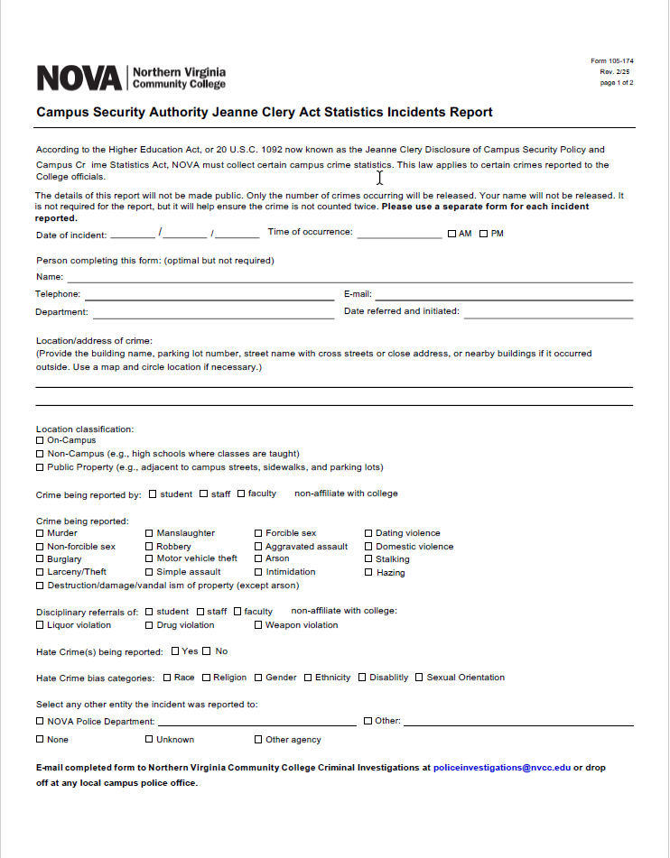
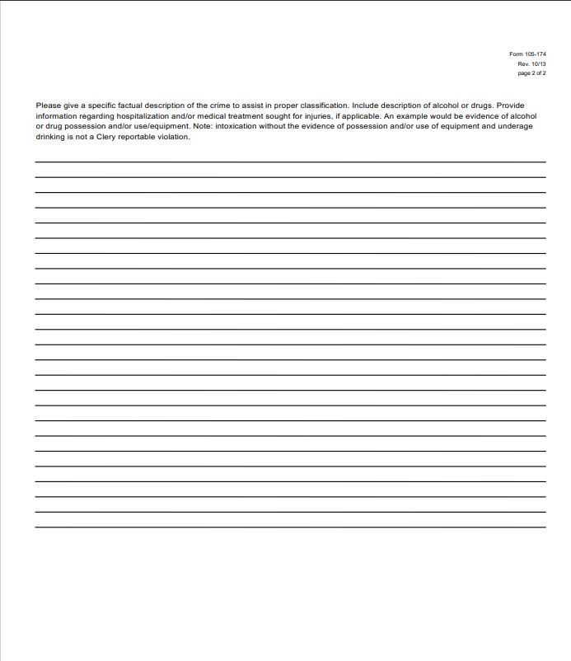
NOVA Form 105-174
The following link will bring you to the most current Form 105-174
https://www.nvcc.edu/forms/pdf/105-174.pdf

Slide 10
NOVA’s Clery Geography
NOVA’s Clery Geography has 3 elements (On-Campus, Non-Campus, & Public Property)
On-Campus
  Any building or property owned or controlled by NOVA within the same reasonably contiguous geographic area of NOVA and used by NOVA in direct support of, or in a manner related to NOVA’s educational purposes
  Property within the same reasonably contiguous geographic area of NOVA that is owned by NOVA but controlled by another person, is used by students, and supports NOVA’s purposes.

Slide 11
NOVA’s Clery Geography – Non-Campus
Non-Campus
  Any building or property owned or controlled by a student organization recognized by NOVA
    &
  Any building or property (non-branch) owned or controlled by NOVA that is used in direct support of in relation to NOVA’s educational purposes, is used by students, and is not within the same reasonably contiguous geographic area of NOVA

Slide 12
NOVA’s Clery Geography - Public Property
Public Property
  Means all public property that is within the same reasonably contiguous geographic area of NOVA’s ON-CAMPUS PROPERTY, such as sidewalks, streets, or thoroughfare, or parking facility, and is adjacent to a facility owned or controlled by NOVA if the facility is used by NOVA in direct support of, or in a manner related to the NOVA’s educational purposes
    The public property requirement does not extend to NOVA’s Non-Campus Properties

Slide 13
NOVA’s Clery Geography Examples
Campus (NOVA previously had 14 Clery Campuses, there are currently 11 Clery Campuses)
    Annandale, Alexandria, Arlington Center, Loudoun, Reston, Manassas, Innovation Park (MIP), Pender/ Fairfax, Woodbridge, Medical Education Campus, Pitney Bowes/ Brault Annex, Fort Myers/ Henderson Hall, Quantico, Fort Belvoir
      Includes request for each building’s individual address if appropriate
      Note MIP closed on October, 2016 and the Arlington Center closed on March, 2016.
      Brault Annex closed September, 2022, Signal Hill closed June, 2024
Public Property
    Includes request for intersections and 100 blocks on streets and roads surrounding NOVA’s Clery campuses
Non-Campus
  Physical Education Classes (Gold’s Gym, bowling)
  Early Childhood classes
  Parks and Recreation Classes
  Intramural Athletics (practice, games, tournaments)
  Student Services Activities (conferences)
  Study Abroad Trips (South Korea)
  Workforce Development non-credit
  Misc. Biology classes, geology classes (trips to MT, WY)
  Global Studies/ International Students (apartments)
  Music Classes (local church's)
  CCIP Student Housing – Non-Campus locations
The following link will bring you to the NOVA Locations webpage: https://www.nvcc.edu/about/locations/index.html

Slide 14
Crime Reporting
In determining whether a crime should be included in the annual crime report, institutions should ask the following three questions?
  Was the crime reported to a Campus Security Authority (CSA)?
  Does the information contain information about a criminal offenses?
  Did the crime occur in a Clery reportable geographic area?
Note
  All crimes are included within the NOVA Daily Crime Log
  Only certain crimes are included within NOVA’s Annual Security Report (ASR)
    Both can be reviewed via the NOVA College Police Clery Compliance webpage

Slide 15
ASR Reportable Clery Crimes and Offenses
Crime statistics include all reported offenses
Four Categories
  Criminal Offenses
    Homicide Non-negligence Manslaughter
    Rape, Fondling, Incest, & Statutory Rape
    Robbery, Aggravated Assault, Burglary, Motor Vehicle Theft, Arson, Hazing
  Hate Crimes
    Any above and below and Larceny-Theft, Simple Assault, Intimidation, Destruction/Damage/Vandalism of Property motivated by BIAS
  VAWA Offense
    Domestic Violence, Dating Violence, Stalking
  Arrest & Referrals for Disciplinary Action
    Weapons – Carrying, Possessing
    Drug Abuse Violations
    Liquor Law Violations (Does Not Include Drunk In Public)
Statistics must be disclosed separately for each of these four general categories. When an incident meets definitions in more than one of these categories it must be reported in each category. Therefore one incident may have multiple associated statistics

Slide 16
NOVA’s Weapons Policy: 108
Highlights
  Defines College property and weapons
  Does not restrict the possession of pepper spray on campus
  Explains that possession or carrying of any weapon by any person on college property in academic buildings, administrative buildings, student centers, child care centers, dining facilities is prohibited unless you fall under an exception
    Exceptions
      Current sworn and certified local, state, or federal law enforcement officer
    The following link will bring you to the most current NOVA Policy Page: https://www.nvcc.edu/dist/files/sites/policies/pdfs/108-Weapons.pdf

Slide 17
Crime Classification Questions
Individual crime classifications as well as examples can be found on the NOVA College Police Clery Compliance webpage at the following link: https://www.nvcc.edu/student-life/college-safety/police/clery-act/definition.html
You can also speak to any NOVA officer in person, or call 703-764-5000 to speak with an officer who would be able to assist you in determining how an incident should be classified

Slide 18
NOVA’s Emergency Notifications
Under the Clery Act, every institution is required to immediately notify the campus community upon confirmation of a significant emergency or dangerous situation occurring on the campus that involves an immediate threat to the health or safety of students or employees.
  An “immediate” threat as used here includes an imminent or impending threat, such as an approaching forest fire, or a fire currently raging in one of your buildings.
  Inherent in this requirement is a statement that your institution will immediately notify the campus community upon confirmation of an emergency or dangerous situation.
  Confirmation means that an institution official (or officials) has verified that a legitimate emergency or dangerous situation exists. Confirmation doesn’t necessarily mean that all of the pertinent details are known or even available.
This requirement does not apply to emergency situations in or on non-campus buildings or property.

Slide 19
Emergency Notifications
The clock starts ticking when you as the CSA are made aware of or become aware of a situation that would require NOVA to issue an Emergency Notification
  examples of significant emergencies or dangerous situations are
    outbreak of meningitis, norovirus or other serious illness;
    approaching tornado, hurricane or other extreme weather conditions;
    earthquake;
    gas leak;
    terrorist incident;
    armed intruder;
    bomb threat;
    civil unrest or rioting;
    explosion; and
    nearby chemical or hazardous waste spill;
****Let the NOVA Police know immediately about any of the listed examples – 703-764-5000

Slide 20
NOVA’s Crisis Communication Protocol
The Director of The Office of Emergency Management and Safety (OEMS) and the Chief of Police are responsible for all Emergency Notifications.
The below NOVA officials will have the authority to send or authorize NOVA Emergency Notifications and are considered “Responsible NOVA Authorities.” At all times in this protocol, referenced positions at NOVA may be replaced by designees.
  NOVA President
  Campus Provost
  Chief of Police
  Director of Office of Emergency Management and Safety (OEMS)
  Vice President of Finance and Administration
  Vice President of Strategy, Research and Workforce Innovation
  Vice President of Student Affairs
  Vice President of Academic Affairs and Chief Academic Officer
  Vice President of IET and College Computing
  Police Dispatch (Can authorize and send severe weather alerts. All other alerts must be authorized by another Responsible NOVA Authority before the alert is sent by a Dispatcher)
NOTE: Executive NOVA Officials and NOVA Police Officers who are directly involved with the emergency response for safety and security incidents are designated as “Responsible NOVA Authorities” for purposes of confirming that a legitimate emergency/dangerous situation exists or authorizing a NOVA Emergency Notification. They are limited to authorizing an initial alert in response to an incident or event within their direct area of responsibility and only in cases in which a delay could compromise the safety and security of NOVA.
The Crisis Communications Protocol can be viewed at the following link via NOVA’s OEMS page: https://www.nvcc.edu/student.../NOVACrisisCommunicationProtocol.pdf

Slide 21
NOVA’s Timely Warnings
The Clery Act requires Colleges to alert the campus community to certain crimes in a manner that is timely and will aid in the prevention of similar crimes. Although the Clery Act doesn’t define “timely,” the intent of a warning regarding a criminal incident(s) is to enable people to protect themselves. This means that a warning should be issued as soon as pertinent information is available.
This is critical; even if you don’t have all of the facts surrounding a criminal incident that represents a serious and continuing threat to your students and employees you must issue a warning.
Crimes Subject to a Timely Warning
  You must issue a timely warning for all Clery Act crimes that occur on your Clery Act geography that are reported to campus security authorities or local police agencies; and
  considered by the institution to represent a serious or continuing threat to students and employees.
The requirement for timely warnings is not limited to violent crimes or crimes against persons.

Slide 22
Timely Warnings
The clock starts ticking when you as the CSA are made aware of or become aware of a situation that would require NOVA to issue a Timely Warning
Encourage all to report to College Police
  If they choose not to report to the College Police
  You and Your Staff Are Responsible
  To fill out form 105-174 with all the pertinent information and submit to any College Police Office or Chief Jacoby so the College Police can evaluate the incident information to determine if Timely Warning implications need to be activated

Slide 23
Emergency Notification vs. Timely Warnings
Emergency Notification
Timely Warning
Scope: Wide focus on any significant emergency or dangerous situation (may include Clery Act crimes),
Why: Emergency notification is triggered by an event that is currently occurring on or imminently threatening the campus. Initiate emergency notification procedures for any significant emergency or dangerous situation occurring on the campus involving an immediate threat to the health or safety of students or employees.
Where: Applies to situations that occur on your campus.
When: Initiate procedures immediately upon confirmation that a dangerous situation or emergency exist or threatens.
Scope: Narrow focus on Clery Act Crimes.
Why: Timely warnings are triggered by crimes that have already occurred but represent an ongoing threat. Issue a timely warning for any Clery Act crime committed on your Clery Act geography that is reported to your campus security authorities or a local law enforcement agency, and that is considered by the institution to represent a serious or continuing threat to students and employees.
Where: Applies to crimes that occur anywhere on your Clery Act geography.
When: Issue a warning as soon as the pertinent information is available.
NOVA’s Emergency Notification and Timely Warning policy can be found at the following policy web link: https://www.nvcc.edu/policies/ see Policy 114 Emergency Notifications – Timely Warnings

Slide 24
NOVA’s VAWA Requirements
VAWA (Violence Against Women’s Act)
Requires NOVA to have programs to prevent Dating Violence, Domestic Violence, Sexual Assaults, and Stalking
  Awareness Programs
  Bystander Intervention Programs
  Ongoing Prevention Programs
  Awareness Campaigns
  Primary Prevention Programs
  Risk Reduction Programs

Slide 25
NOVA’s VAWA Programs
Various NOVA Departments and Divisions provide trainings/ seminars/ campaigns to combat Domestic Violence, Dating Violence, Sexual Assaults, and Stalking
  Please review the related training information in the Annual Security Report or visit the NOVA Police Clery Compliance Training webpage
This enables NOVA to maintain a multi layered approach to fulfilling the below VAWA training requirements
  Awareness Programs
  Bystander Intervention Programs
  Ongoing Prevention Programs
  Awareness Campaigns
  Primary Prevention Programs
  Risk Reduction Programs

Slide 26
NOVA’s Stop Campus Hazing Act
The Stop Campus Hazing Act was passed and enacted on January 3, 2025
  Requires NOVA to have a Hazing Policy
  Requires NOVA to provide training for prevention and awareness programs
  Requires NOVA to create a “Campus Hazing Transparency Report”
  Requires NOVA to include data in the Annual Security Report

Slide 27
Hazing Defined by the law
Intentional, knowing, or reckless act by a person(s) against another person(s) regardless of the willingness of victim that is committed for initiation, affiliation, or maintenance of membership in a student organization such as:
  Whipping, beating, striking, electronic shocking, harmful substance on body, or similar
  Causing, coercing, inducing sleep deprivation, exposure to elements, confinement in small spaces, extreme calisthenics, or similar
  Causing, coercing, inducing consumption of food, liquid, alcohol, drugs, or other substance
  Causing, coercing, inducing a person to perform sexual acts
  Any activity that places a person in reasonable fear of bodily harm through use of threatening words or conduct
  Any activity against another that includes a criminal violation of local, state, or federal law
  Any activity that induces, causes, or requires a person to perform a duty or task that involves a criminal violation of local, state, federal law
A student organization is:
An organization such as club, society, association, varsity or junior varsity athletic team, club sports team, fraternity, sorority, band, or student government
In which TWO OR MORE members are students enrolled at NOVA
Whether or NOT the organization is established or recognized by NOVA

Slide 28
End of Training
Clery Compliance applies to everyone at NOVA
NOVA College Police coordinates Clery Compliance but all NOVA’s departments and divisions play an important roll in maintaining Clery Compliance
NOVA College Police Department
4001 Wakefield Chapel Rd.
Annandale, VA. 22003
703-764-5000

