Slide 1
Work-Study Supervisor Training

Slide 2
1
Topics
Program
Overview
2
How to Hire
Work-Study
Students
3
Policies &
Procedures
4
Job-X
Website

Slide 3
Work-study is a program that allows eligible students to earn money toward their educational expenses. Work-study students assist with daily operations at the college and other projects. Students are supervised by current NOVA employees who have agreed to serve as work-study supervisors.
What is Work-Study?
1
Program
Overview

Slide 4
Coordination of the Work-Study Program
There is a Campus Work-Study Coordinator on each campus who oversees the work-study program on their campus.
Campus Work-Study Coordinators:
Work in the Campus Financial Aid Office.
Serve as the primary contact for students and supervisors to answer work-study questions.
Advertise the work-study program and help recruit work-study students on their campus.
Disseminate work-study information throughout the year to supervisors and students.
Request work-study awards for potentially eligible students.
Assist students with completing the work-study employment paperwork.
Assist supervisors with using the Job-X website to hire new work-study students.
Collect and review work-study employment documents from students and supervisors.

Slide 5
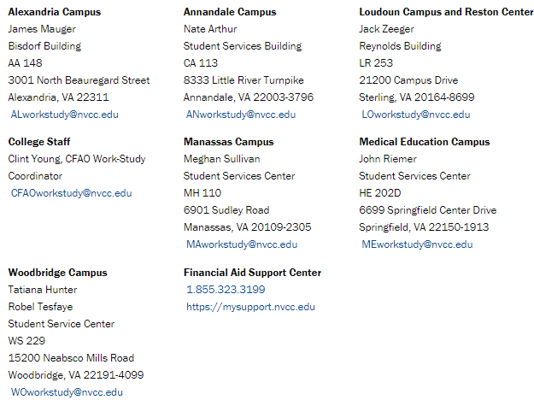
Meet Your Campus Work-Study Coordinator

Slide 6
Coordination of the Work-Study Program
There is also one College Work-Study Coordinator who manages the oversight of the entire work-study program at NOVA.
CFAO Work-Study Coordinator:
Works in the College Financial Aid Office.
Ensures that the program remains in compliance with federal and institutional regulations.
Develops and implements work-study policies and procedures.
Sends work-study information to students and Campus Work-Study Coordinators.
Provides training for Campus Work-Study Coordinators and supervisors, as necessary.
Manages and reconciles the college-wide work-study program budgets.
Tracks work-study earnings and notifies students when they must stop working.
Verifies student eligibility and certifies all work-study awards.
Reviews Work-Study Agreements and employment documents before sending them to HR.
Notifies students, supervisors, and Campus Work-Study Coordinators if/when a student’s Work-Study Agreement is approved by the College Financial Aid Office.
Serves as the Campus Work-Study Coordinator for College Staff.

Slide 7
Benefits of the Work-Study Program for Students
On-campus job
Flexible schedule
Enhance employment skills
Earn money toward educational expenses
Gain experience related to their academic and/or career goals.
Potentially obtain a reference from their supervisor.
Federal work-study earnings do not reduce future aid eligibility.

Slide 8
Benefits of the Work-Study Program for NOVA Supervisors
Extra Help in Your Office!!!
Earnings are paid from the Work-Study Budget
(Not from your Department Budget)
If the student remains eligible and
If their earnings do not exceed their work-study award.

Slide 9
Federal Work-Study NVCC Work-Study International Work-Study
Three Types of Work-Study

Slide 10
Federal Work-Study (FWS)
FWS is a form of need-based federal financial aid.
About 95% of all work-study jobs at NOVA are FWS jobs.
The FWS program budget for 2021-22 is $1,205,283.
To be eligible for a FWS award, students must:
Complete the FAFSA at www.studentaid.gov.
Submit any items that may be on their myNOVA To Do List.
Qualify for federal financial aid.
Have remaining financial need demonstrated through their FAFSA.
Be enrolled in at least 6 eligible credits during the semester they want to work.
Meet the Satisfactory Academic Progress requirements.
Be US citizens or eligible non-citizens (i.e. permanent residents, or students with an I-94 that show Asylum or Refugee status).
If students meets these requirements, but were not offered a FWS award
then they may contact their Campus Work-Study Coordinator
to confirm if they are eligible and to request a FWS award if funding is available.

Slide 11
NVCC Work-Study
The NVCC Work-Study program is funded by the College.
About 4% of all work-study jobs at NOVA are NVCC Work-Study jobs.
The NVCC Work-Study budget for 2021-22 is $55,000.
To be eligible for NVCC Work-Study, students must:
Be enrolled in at least 6 credits during the semester they want to work.
Meet the Satisfactory Academic Progress requirements.
Be eligible to work in the US.
NVCC Work-Study is open to US citizens, permanent residents, students with an I-94 that show Asylum or Refugee status, and F1 students.
* There is no financial need requirement for NVCC Work-Study.
If students meet these requirements,
they may contact their Campus Work-Study Coordinator
to request a NVCC Work-Study award if funding is available.

Slide 12
International Work-Study
The 2021-22 International Work-Study program is $12,500 (about 1% of work-study jobs).
The International Work-Study program is funded by the College.
To be eligible for International Work-Study, students must:
Be enrolled in at least 6 credits during the semester they want to work. (12 credits are generally required each semester for their F1 visa)
Meet the Satisfactory Academic Progress requirements.
Have experienced a financial hardship as certified by the Office of International Students (OIS) and be eligible to work on campus (as confirmed by OIS or the Campus DSO).
If a F1 student has experienced a financial hardship, they should first contact their Campus Work-Study Coordinator to determine if International Work-Study funding is available.
If funding is available, they should contact the Office of International Students to apply.
The Office of International Students will select students to be hired for this program. Those students will submit their employment documents to their Campus Work-Study Coordinator.

Slide 13
Work-Study Program Overview
Awards generally range from $1,500 - $2,500 per semester.
The amount of the award is posted on myNOVA and listed on the Work-Study Agreement.
All first-year work-study students are paid $12 per hour.
After at least two full semesters of participation in the program, students can be paid $13 per hour.
Pay increases are only done at the beginning of the fall semester.
Work-Study Agreements (NVCC Form 125-175) are usually done for fall-spring with a separate agreement for summer (if eligible).
Summer awards are separated into Summer 1 and Summer 2.
Supervisors and students are notified of the dates students can work each semester (if they remain eligible).
Students must stop working immediately if they become ineligible.

Slide 14
The Hiring Process
2
The student must be eligible for work-study and have a work-study award posted on myNOVA. Students should contact their Campus Work-Study Coordinator if they think they’re eligible, but have not been offered a work-study award.
Supervisors can re-hire former work-study students if they are still eligible or recruit new work-study students by posting positions on the Job-X website. Only students with work-study awards listed on myNOVA can submit an application on Job-X.
Supervisors interview work-study candidates and determine who they want to hire.
Supervisors complete Section B of the Work-Study Agreement with the student they want to hire. This form must then be submitted to the Campus Work-Study Coordinator. New work-study students who have not participated in the program within the last 12 months must also submit the work-study employment packet to their Campus Work-Study Coordinator. Rehire documents must be submitted for students who were terminated or who have not worked within the past month.
How to Hire
Work-Study
Students

Slide 15
The Hiring Process (continued…)
2
The supervisor hires the student through the Job-X website if the student has not previously worked in the supervisor’s office.
The Campus Work-Study Coordinator will review the employment documents and forward the documents to the College Work-Study Coordinator.
The College Work-Study Coordinator will determine if the work-study award can be certified, update budget records and forward the employment documents to Human Resources.
The College Work-Study Coordinator will email the student, supervisor, and Campus Work-Study Coordinator if the student’s work-study employment is approved by the College Financial Aid Office. The number of hours a student can work, next steps, etc. will also be confirmed.
A few days later, the student should receive an email from Applicant Insight with instructions for completing the electronic background check consent form. Failure to complete this in a timely manner may delay the start date.
How to Hire
Work-Study
Students

Slide 16
The Hiring Process (continued…)
2
10) If the student’s employment is approved by Human Resources, then the employment documents are sent to the Payroll Office and HR will email the supervisor to confirm that the student is approved to work.
Supervisors may email dataops@nvcc.edu if they have not received an email from HR confirming that the student’s employment was approved within two weeks after they receive the email confirmation from the College Financial Aid Office.
11) The work-study student will need to complete annual IT Security Awareness Training. This is the same training that full-time employees complete each year.
12) Supervisors may submit a 105-45 at www.nvcc.edu/forms if the
work-study student needs additional access to SIS, a phone, etc.
How to Hire
Work-Study
Students

Slide 17
Summary of the Hiring Process
Student
Work-Study Supervisor
Campus Work-Study Coordinator
College Work-Study Coordinator
Human Resources
IT
Payroll

Slide 18
Reminders
All Work-Study Agreements and other work-study employment documents must be submitted by the student to the Campus Work-Study Coordinator.
Supervisors and students should contact their
Campus Work-Study Coordinator if they have any questions
about the work-study program or the hiring process.
Students should never be allowed to start working before their employment is approved by the College Financial Aid Office and
the Human Resources Department.

Slide 19
Review the Work-Study Employment Packet
The Work-Study Employment Packet is available in the Student Forms Library.
All new work-study students who have not participated in the program within the last 12 months must complete a new employment packet.
If a student is being re-hired after more than a 30-day break in employment or after being terminated, then the rehire documents must be submitted.
Please use the Employment Packet Checklist.
Reminder: The I-9 Form should only be completed by the
Campus Work-Study Coordinators.
Supervisors only need to complete the Work-Study Agreement.
The first day of employment listed in Section 2 of the I-9 form must be the first day of the next work-study pay period (or the first day of the following pay period if it is less than 10 days away).

Slide 20
The Work-Study Program policies and procedures have been developed to: 1) Ensure that the program is in compliance with both federal and institutional regulations. 2) To facilitate the coordination of the program. 3) Make all processes as streamlined as possible for all parties involved.
Policies and Procedures
3
Policies &
Procedures

Slide 21
Work-Study Program Policies
Most of the program’s policies are listed on the Work-Study Agreement (NVCC Form 125-175).
Additional information is available at www.nvcc.edu/workstudy.
Updates and reminders are emailed to students and supervisors throughout the year.
Ask your Campus Work-Study Coordinator if you have any questions.

Slide 22
Work-Study Agreement Policies
Before students can start working each semester they must:
Have an accepted work-study award posted on MyNOVA.
Enroll in at least 6 eligible credits for the current semester.
Wait until the first day students are allowed to work
(if approved before the semester begins).
The supervisor must receive an email from the College Work-Study Coordinator confirming that the student’s employment was approved by the Financial Aid Office.
The supervisor must receive an email from HR confirming that the student’s employment was approved.

Slide 23
Work-Study Agreement Policies
Students must stop working if any of the following occur:
Their enrollment drops below 6 eligible credits.
They fail to meet the SAP requirements.
They have earned their full work-study award for the semester.
They are notified by the Financial Aid Office or their supervisor that they must stop working.
If summer work-study students earn their full “Summer 1” award before the end of June they must stop working. Any unearned portion of “Summer 1” and “Summer 2” work-study awards can be earned in July until the last day of the summer work-study program.

Slide 24
Work-Study Agreement Policies
6) All work-study students must stop working by the last day of final exams of the semester they were approved to work. If an earlier end date is necessary due to how the pay periods break between semesters, that date will be communicated to students and supervisors by the College Work-Study Coordinator.
Students approved for fall/spring work-study awards can continue working until the College closes for Winter Break and resume working when the College reopens in early January if they are enrolled in at least 6 eligible credits and are still meeting the SAP requirements.

Slide 25
Work-Study Agreement Policies
Students cannot earn more than their fall semester work-study award during the fall semester.
Any remaining portion of a fall/spring work-study award can be earned during the spring semester.
A new Work-Study Agreement must be submitted and approved in order for the student to participate in the summer work-study program.
A new Work-Study Agreement is also required whenever the student’s supervisor changes.

Slide 26
Work-Study Agreement Policies
A supervisor’s department budget can be charged if:
The student’s earnings exceed the student’s approved work-study award for the applicable semester.
The supervisor allows the student to start working before the student is eligible to start working.
The supervisor allows the student to continue working after the student is no longer eligible to work, including after the Work-Study Agreement ends.
The student’s enrollment drops below 6 eligible credits and the student continues working after the student and supervisor are notified that the student must stop working.
Notes:
Students cannot be paid with federal funds that they are not eligible for.

Slide 27
Work-Study Agreement General Policies
Work hours cannot conflict with class time.
Students must clock out for personal time, to eat, or to study.
A student cannot have any other paid position at NOVA while participating in the work-study program.
Students may not work more than 15 hours per week.
All work-study awards are contingent on the student’s continued eligibility, funding, and approval by HR and the CFAO.
An offered work-study award is no guarantee that the student will be approved to work (funding may become exhausted before the student is approved to work, the student’s eligibility may change, or they may not find a supervisor who wants to hire them, etc.)

Slide 28
Work-Study Agreement General Policies
Job-X must be used to hire new work-study students and students who are transferring from another department.
Students should submit their hours in HRMS at the end of each day they work per the Human Resources Department.
If the supervisor approves the timesheet after the date due in payroll then the student will not be paid until the next pay-date.
Supervisors must immediately notify the Campus Work-Study Coordinator if a student stops working for any reason.
Supervisors must submit the 125-300 form to the Campus Work-Study Coordinator if they wish to convert a work-study student to a student-hire. If the supervisor wishes to convert the work-study student to a P-14 on a permanent basis (as opposed to just a temporary basis due to less than half-time enrollment for the summer) then the supervisor also needs to complete an EWP in NATS and a competitive search will need to be performed.

Slide 29
Supervisor Responsibilities
Be a good supervisor!
Abide by and enforce the work-study program policies.
Treat all students fairly and remember that school is the student’s first priority, but students cannot be paid to study.
Interview work-study candidates and determine who you want to hire.
Agree upon a work-schedule and set clear expectations for the student up-front.
Complete Section B of the Work-Study Agreement and have the student return it to the Campus Work-Study Coordinator along with their employment packet.
Provide training, feedback, and enough work to keep the student busy.
Keep track of your work-study student’s earnings! Keep a log of all the hours approved.
Make sure students do not earn more than their work-study award and that they stop working when they’re required to.
Approve the student’s timesheet in HRMS by the date due in payroll.
Do not allow students to work more than 15 hours per week.
Submit a 105-45 if your student needs additional IT access.
Notify your Campus Work-Study Coordinator if a student stopped working.
Complete a performance evaluation of the student at the end of each semester.
Let your Campus Work-Study Coordinator know if you have any questions or concerns!

Slide 30
Addressing Performance Issues
Set clear expectations up front and train your work-study students.
Provide on-going coaching and constructive feedback.
If performance issues do not improve, supervisors have the following options:
Give a verbal warning.
a) Explain the constructive purpose of your feedback to the student.
b) Discuss the specific behavior you observed.
c) Provide suggestions for improvement and agree on a solution.
Give a formal written warning. Keep this form for your records.
Terminate the student. Notify your Campus Work-Study Coordinator and submit an Employee Separation Notification (Form 105-021) with the student’s information to terminate the student.

Slide 31
When are Work-Study Placements Made?
Most fall/spring work-study placements are typically made in July, August, and early September.
Spring placements are usually made in January if funding becomes available. This can occur if other students who were previously placed for fall/spring become ineligible to continue working in the spring.
Most summer work-study placements are made in April and early May.
Placements can be made at other times throughout the year if funding is available.
Your Campus Work-Study Coordinator can let you know if funding is still available.

Slide 32
Transferring to a Different Department
Once students have accepted a work-study job they are expected to remain at that job-site for the duration of their Work-Study Agreement.
Reassignment to another department before the Work-Study Agreement has ended will be considered in extenuating circumstances and approval will be at the discretion of the Financial Aid Office.
A new Work-Study Agreement must be submitted to the Campus Work-Study Coordinator to request a transfer to a different department.

Slide 33
Student Rights & Responsibilities
See the Work-Study Student Rights and Responsibilities Form.
It’s part of the work-study employment packet.

Slide 34
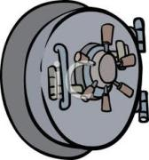
Family Educational Rights and Privacy Act (FERPA)
Supervisors must train students about FERPA and enforce the FERPA policy.
See the FERPA Non-Disclosure Agreement in the employment packet.
The unauthorized disclosure of student records is prohibited.

Slide 35
Submitting Timesheets in HRMS
Training on submitting time in HRMS is available at https://www.nvcc.edu/hr/data-ops.html.
Students obtain access to HRMS when their work-study employment packet is approved by Human Resources and their basic LAN account is created by the IT Help Desk.
Students should submit their hours in HRMS at the end of each day they work.

Slide 36
Approving Timesheets in HRMS
Manager training for approving time in HRMS is available at https://www.nvcc.edu/hr/data-ops.html.
Get your Dynamic Group ID number to approve easily approve timesheets for multiple employees.
The student should be added to the supervisor’s HRMS when Human Resources processes the Work-Study employment documents.
New supervisors must submit a 105-45 to get access to the Manager Self Service screens in HRMS. If necessary, supervisors can email dataops@nvcc.edu in order to get timesheets approved before they obtain access to HRMS.
Supervisors must approve timesheets by the Date Due in Payroll as noted on the Payroll Working Calendar or the student’s pay will be delayed.

Slide 37
Job-X is the website that is used to post on-campus work-study positions. It is a job management system that is used to recruit, hire, and reject applicants.
What is Job-X?
4
Job-X
Website

Slide 38
Using Job-X
Job-X must be used to recruit and hire any work-study student who has not previously worked in the supervisor’s office.
New work-study supervisors will need to request a login to be able to use Job-X.
Supervisors can post work-study positions on the Job-X website after their initial login request is approved by the College Work-Study Coordinator.
The 5-digit Job ID from the position description in Job-X must be provided on the work-study agreement.

Slide 39
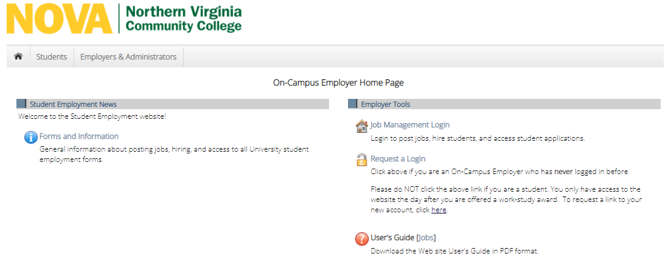
Job-X On-Campus Employer Home Page
https://nvcc.studentemployment.ngwebsolutions.com/Cmx_Content.aspx?cpId=11

Slide 40
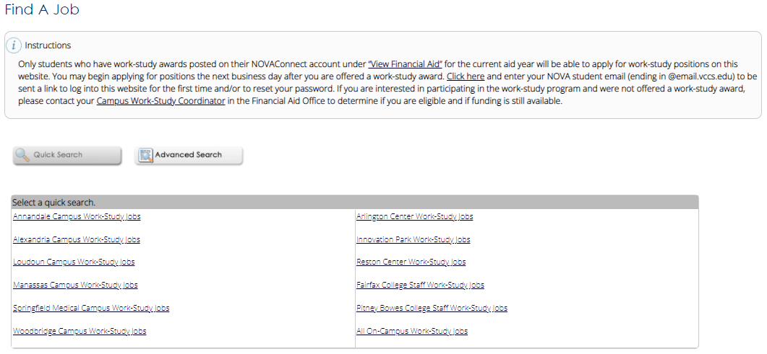
Job-X Database of Available Work-Study Jobs
Students may apply for work-study positions at
https://nvcc.studentemployment.ngwebsolutions.com/JobX_FindAJob.aspx

Slide 41
How do Supervisors Use Job-X?
Please review the
Employer Training Presentation
and the
User’s Guide [Jobs]
Visit the On-Campus Employer Home Page.
Please let your Campus Work-Study Coordinator know if you have any questions!

Slide 42
QUESTIONS?

