Slide 1
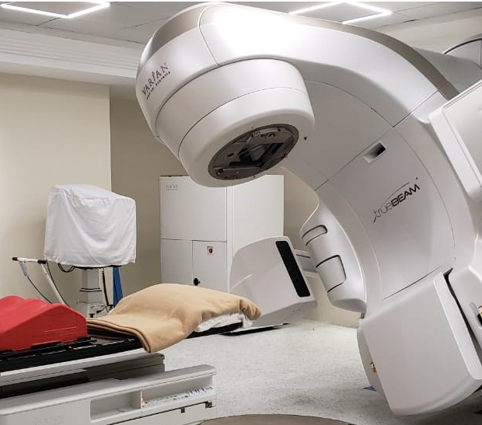
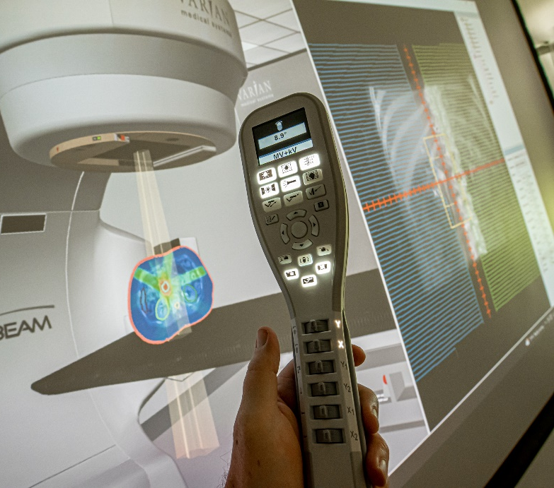

RADIATION ONCOLOGY information session
VWCC AND NOVA
JOINT VENTURE
Last Updated September 2025
Linear accelerator (LINAC)
Virtual linear accelerator

Slide 2

About this joint venture
Virginia Western Community College (VWCC) and Northern Virginia Community College (NOVA) are both part of the Virginia Community College System (VCCS). These two colleges partnered in 2007 to make the Virginia Western Radiation Oncology Program available here in Northern Virginia.
This opportunity allows students to complete an accredited program at NOVA that prepares them to sit for the ARRT Radiation Therapy certification exam after graduation. Students earn an associate degree in approximately 21 months. They complete classes at both colleges, and after successfully completing the program, they receive an associate in applied science degree in Radiation Oncology from Virginia Western Community College. No travel to Virginia Western Community College is required during the program.
NOVA and Virginia Western logos

Slide 3
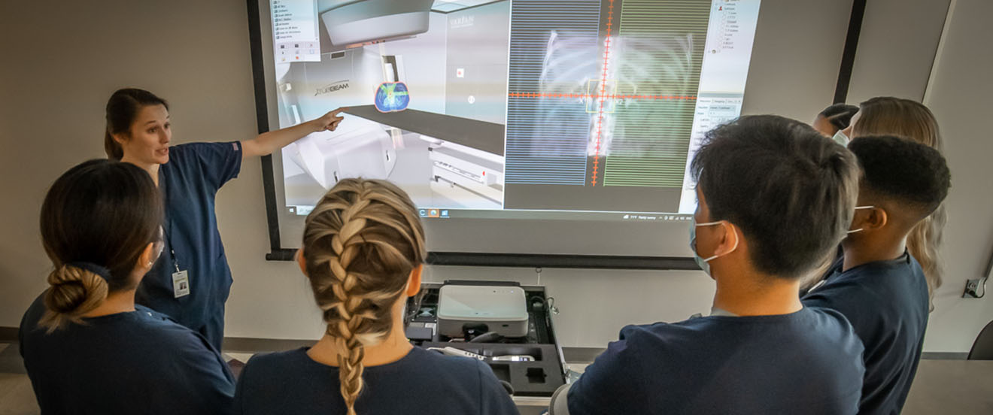
Program at-a-glance
Apply by: March 15
Admission Policy: Competitive
Program Location: Medical Education Campus Springfield, Virginia
Program Size: 10 students
Program Length: Approximately 21 months
Program Starts: Every August
ROC students practicing on the virtual linear accelerator (VERT)
Medical Education Campus, Health Sciences Division 6699 Springfield Center Drive, Springfield, VA 22150

Slide 4

Program accreditation
The VWCC/NOVA Radiation Oncology program is accredited by the Joint Review Committee on Education in Radiologic Technology (JRCERT) Contact Information 20 North Wacker Drive, Suite 2850 Chicago, IL 60606-3182 Phone: 312.704.5300 | Email: mail@jrcert.org
www.jrcert.org/programs/virginia-western-community-college-2/
Program completion data, registry exam pass rates, credentialing, and job placement statistics are available under Program Effectiveness Data at the VWCC program website.
www.virginiawestern.edu/academics/health-professions/radiation-oncology
JRCERT logo

Slide 5
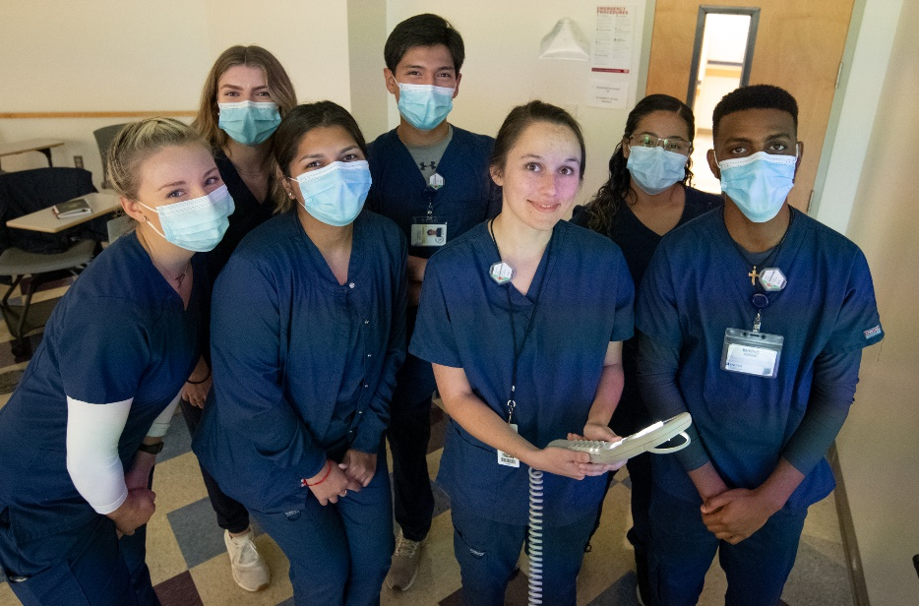
What radiation therapists do
Treat patients with cancer and other diseases by administering radiation treatments
Simulate patients for accurate treatment planning
Work with other radiation therapists, radiation oncologists, nurses, dosimetrists, and physicists
Work in hospitals and cancer clinics
To see salary information, go to www.bls.gov and search Radiation Therapist
Radiation Therapy students

Slide 6
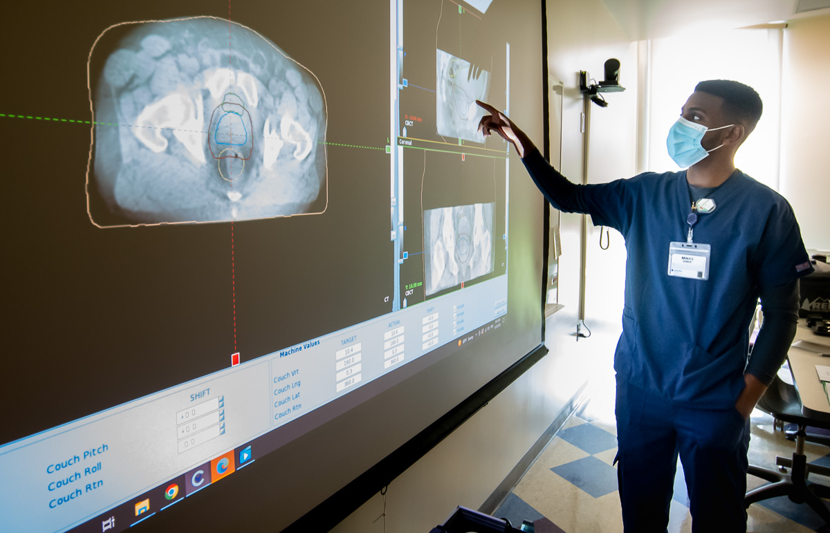
How to get started
Apply to both Virginia Western CC and NOVA
Complete the pre-application requirements
Apply to the program by the deadline
If accepted:
Complete the clinical requirements
Successfully complete the program and graduate
Successfully pass the ARRT RT(T) registry exam
Student using the virtual linear accelerator in lab

Slide 7
APPLY TO Virginia western
Apply to Virginia Western at www.virginiawestern.edu
Select the current semester so you can enroll in classes after applying
Select the CSC Introduction to Radiation Oncology plan to complete prerequisites
Reapply to the college if it has been more than 3 semesters since you enrolled in classes
Academic Calendar: www.virginiawestern.edu/academic-calendar

Slide 8
APPLY TO NOVA
Apply to NOVA at www.nvcc.edu
Select the current semester so you can enroll in classes after applying
Select the Health Sciences Associate of Science degree to complete prerequisites
Reapply to the college if it has been more than 3 semesters since you enrolled in classes
Academic Calendar: www.nvcc.edu/academics/calendar

Slide 9
Complete pre-application reqs
Complete the pre-application requirements by enrolling in available classes on the Student Information System (SIS)
Prerequisites may be taken at any campus they are offered including NOVA Online, and online with Virginia Western Community College (if available)
High-school students may be eligible to complete requirements while still finishing high school
How to Enroll in Classes on SIS: www.nvcc.edu/admissions/register
VW Schedule of Classes: www.virginiawestern.edu/classes
NOVA Schedule of Classes: www.nvcc.edu/academics/schedule
HS Dual Enrollment Procedures: www.nvcc.edu/admissions/dual-enrollment

Slide 10
pre-application requirements
Review the Radiation Oncology Overview and Application Checklists at the Virginia Western Radiation Oncology website for the most current list of requirements.
Radiation Oncology Overview www.virginiawestern.edu/wp-content/uploads/2021/01/RadiationOncologyOverview.pdf
Radiation Oncology Application Checklist www.virginiawestern.edu/wp-content/uploads/2021/06/RadiationOncologyChecklist.pdf

Slide 11
Transcript evaluation
Obtain official transcripts from all non-VCCS colleges attended (transcripts for VCCS colleges are not required)
Obtain official high school transcripts (high school transcripts are required from all applicants, including those with college degrees)
Request transcripts be sent to your home address, so you are aware when they are received
Do not open any envelope that contains transcripts (opened transcripts are no longer “official” and will not be accepted)
Electronic Transcripts (e-transcripts, Parchment, etc.) are acceptable. Select allied health undergraduate for parchment
International transcripts must be evaluated by an approved organization (such as WES) before transfer credit can be determined. If you attended a foreign high school and cannot obtain a transcript, you may provide a written statement to explain why you are unable to provide it
Mail all materials in one larger envelope directly to Pam Woody at Virginia Western Community College - Health Professions, 3091 Colonial Ave., Roanoke, VA 24015
If any school refuses to issue "official" transcripts directly to you, please request they be sent directly to Pam Woody at Virginia Western Community College using the address above
Early applicants should remember that if you enroll in any courses at a non-VCCS school after your application is on file, you will be responsible for having “official” transcripts sent to VWCC directly after grades are posted by that institution. Have updated transcripts mailed to Pam Woody before the application deadline
Radiation Oncology courses are sequential and will take the same amount of time to complete even if some courses are transferred or taken early

Slide 12
Domicile admission policy
The VCCS Admission Policy for Programs with Limited Enrollment states that students are accepted into the program on the following priority basis:
1. Legal residents domiciled in the cities and counties supporting the College
2. Other Virginia legal residents
3. Out-of-state applicants
4. International students requiring Form I-20
This policy is established by the Virginia Community College System and is stated in section 6.0.5 Admission Priorities of the VCCS Policy Manual.
In-state Tuition Eligibility: www.virginiawestern.edu/about/legal-and-policies/policies/student-affairs/i-30

Slide 13
Essential functions
Essential Functions are a group of minimal physical and cognitive abilities as well as sufficient mental and emotional stability to confirm that students are able to complete the entire course of study, participate fully in all aspects of training, and be deployable as competent Health Sciences and Nursing students, with or without reasonable accommodation.
Review the Radiation Oncology Program Essential Functions: www.virginiawestern.edu/academics/health-professions/radiation-oncology/essential-functions

Slide 14
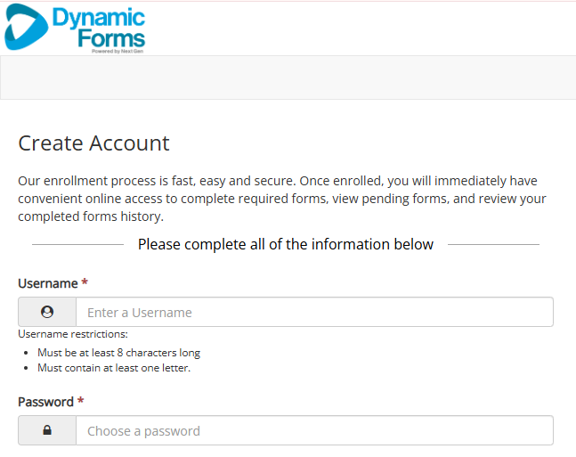
How to apply
Apply by March 15 after meeting all requirements
Make sure you have applied to both VWCC and NOVA
Have all official high school and college transcripts or GED scores
Have two letters of recommendation from employers/professors
Have a copy of any healthcare licensure or certification (if applicable-not required)
Complete a Virginia Western Radiation Oncology Application
Indicate NOVA for your campus preference on the application
Follow all directions on the VWCC Radiation Oncology application website to create an account and successfully submit your application package
Early application is highly recommended
www.virginiawestern.edu/academics/health-professions/radiation-oncology/apply
Screenshot of the account creation step on the Radiation Oncology Application

Slide 15
After application
All communication regarding the application process will be sent to the email associated with your Navigate account
Qualified applicants will receive an interview process letter and a final fall status letter to the email listed in Navigate
Please be aware of the email account associated with your Navigate platform and turn on your notifications in Navigate
Qualified applicants may be contacted from mid April to mid May to schedule the program interview
Navigate Resources: www.nvcc.edu/student-resources/advising/navigate.html

Slide 16
Competitive admission
Meeting the minimum application requirements does not guarantee acceptance
Admission in the program is competitive
There are 10 openings for NOVA each year
Interviews for qualified applicants are in mid-April to mid May each year
What the interview committee looks at:
Overall GPA
Math/science GPA and background
Understanding the job of a radiation therapist
Written communication skills
Personal interview conduct and oral communication skills
Letters of recommendation
Existing credentials in healthcare field (not required but is considered)

Slide 17
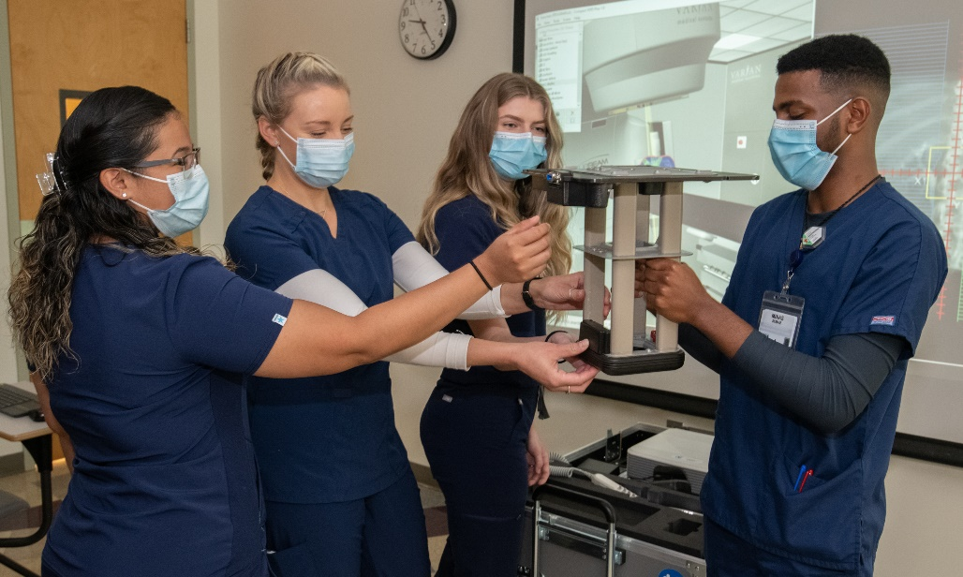
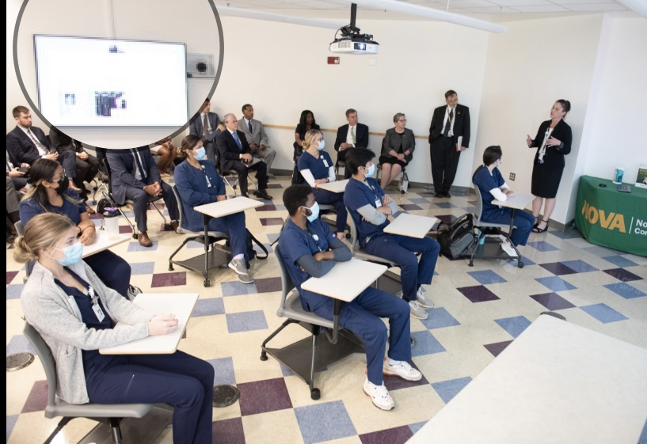
Radiation oncology program
Full-time, 21-month program including the summer
Program cannot be completed part-time; employment is not recommended past the start of the summer semester
Students must earn a grade of C or higher in all classes to advance each semester
Distance learning technology connects students in a classroom at the NOVA Medical Education Campus with the Virginia Western professors and students for didactic (lecture) courses of the program
Clinical courses are taught by an instructor at NOVA
Other courses are delivered online or are taught asynchronously with students completing assignments by the due dates on their own time
Students also have open practice labs using a virtual linear accelerator
No travel to VWCC is required except for optional attendance at the VWCC pinning ceremony and graduation at the end of the program
Radiation therapy students practicing in lab
ROC students meeting in a classroom at MEC

Slide 18
roc program Schedule
First Year, Fall Semester
Lectures/labs at MEC on Wednesdays, other courses online
First Year, Spring Semester
Lectures/labs at MEC on Wednesdays, other courses online
Clinical Rotations at sites in Northern Virginia on Tuesdays and Thursdays 8 am - 4:30 pm
Summer Semester, 10 Weeks
Clinical Rotations at sites in Northern Virginia Monday-Friday 8 am - 4:30 pm, 40 hours per week
Second Year, Fall Semester
Lectures/labs at MEC on Thursdays
Clinical Rotations at sites in Northern Virginia on Mondays, Wednesdays, and Fridays 8 am - 4:30 pm
Second Year, Spring Semester
Lectures online and/or at MEC on Tuesdays and Thursdays
Clinical Rotations at sites in Northern Virginia on Mondays, Wednesdays, and Fridays 8 am - 4:30 pm

Slide 19
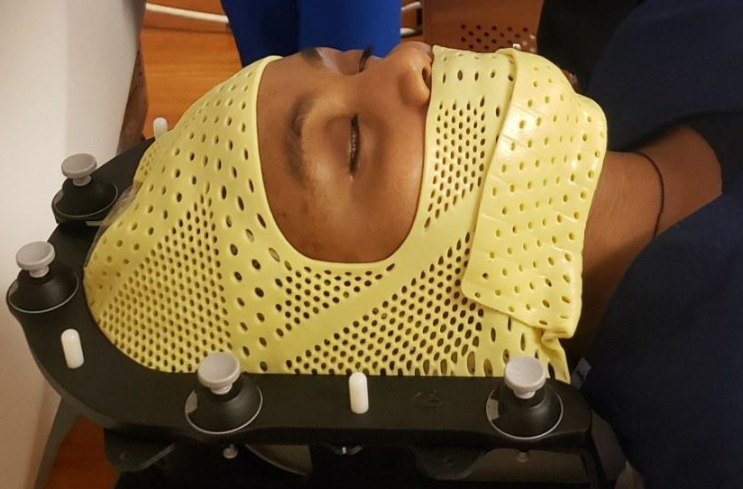
Clinical requirements
Students may be regularly exposed to:
Ionizing Radiation
Infectious Diseases
Terminally ill patients
Combative/difficult patients
Urine/feces/blood and other potential hazards
Before attending clinicals, students must complete:
Annual Background Check with Drug Screen, results compliant with clinical affiliate requirements
Current CPR – American Heart Association BLS for Healthcare Providers Certification
Current physical exam and immunizations compliant with clinical affiliate requirements
Ability to Perform Essential Functions Form
Patient in a radiotherapy mask – a thermoplastic mask used in radiation therapy to hold a patient's head and neck still for precise treatment delivery

Slide 20
Clinical locations
Hospitals participate on a voluntary basis
Clinical schedules and locations are assigned
Students must be willing/able to travel to all rotation sites in Northern Virginia
To assure success, a commute of more than one hour from the DC area is not recommended
Clinical placement is based on educational opportunities at each site, not on home address/location
Clinical Site Locations:
Fairfax
Fair Oaks
Reston
Winchester
Alexandria
Gainesville
Woodbridge
Loudoun
Washington, DC

Slide 21
ROC program expenses
Expenses include, but are not limited to:
Tuition and textbooks
Uniforms
Physical exam with immunizations
Annual background check/drug screen
AHA BLS for Healthcare Providers CPR class
ARRT fees (board exam)
ASRT membership fees
Parking (campus and clinical)
Travel expenses
Clinical tracker packages
Estimated Costs: www.virginiawestern.edu/academics/health-professions/radiation-oncology/cost

Slide 22
Financial aid consortium
Federal financial aid students need to be aware of how consortium agreements work
A consortium agreement allows a student to enroll in courses at two different academic institutions while receiving federal financial aid based on their total enrollment across both schools
Home institution (VWCC): The school from which the student will receive their degree. This institution disburses the financial aid
Host institution (NOVA): The school where the student takes supplementary courses. The credits are transferred back to the home institution to count towards the degree
Please be aware that NOVA has an enrollment cancellation policy where classes will be dropped if the tuition is not paid by a certain date
Tuition deadlines are posted each semester in the NOVA Academic Calendar
Federal aid disbursal from VWCC will most likely happen after the tuition deadline at NOVA
Students with federal aid must plan payment for their NOVA courses up front to hold their registration during enrollment cancellation
Students will be reimbursed for their NOVA courses when the federal aid is disbursed by Virginia Western Community College
NOVA offers a payment plan where students can make smaller payments over time

Slide 23
Arrt RT(T) exam eligibility
Students must disclose criminal convictions to ARRT prior to sitting for the certification board exam per the ARRT Standards of Ethics
Questions regarding eligibility must be addressed directly with ARRT
Contact ARRT to request a pre-application review to determine certification eligibility
Visit ARRT at www.arrt.org for more information

Slide 24
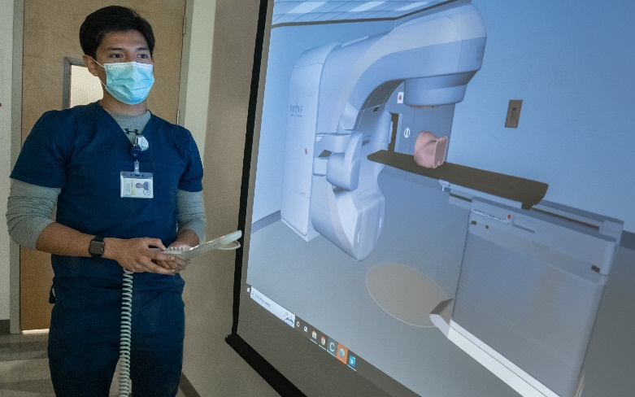
Graduation and licensure
Students are awarded an Associate of Applied Science (AAS) degree in Radiation Oncology from Virginia Western Community College after successful completion of the program
Graduates are eligible to obtain national RT(T) certification through the American Registry of Radiologic Technologists (ARRT)
www.arrt.org/pages/earn-arrt-credentials/credential-options/radiation-therapy
Graduates are also eligible to obtain a Bachelor of Science in Health Sciences, Health Services Administration Professional from Old Dominion University
www.odu.edu/academics/programs/undergraduate/health-services-administration
ROC student practicing on the VERT

Slide 25
Contacts and FAQ
For assistance with application requirements and transcripts: Pam Woody, Jasmine Terry, and the Program Advising Team
healthprofessions@virginiawestern.edu
VWCC Radiation Oncology Program Advisory Team
Rhonda Perdue rperdue@virginiawestern.edu
For assistance with Radiation Oncology career questions:
NOVA Radiation Oncology Clinical Coordinator
Dr. MaLora Bush, DHSc, CMD, RT(T) mbush@nvcc.edu
Frequently Asked Questions: www.virginiawestern.edu/academics/health-professions/radiation-oncology/faq
Virginia Western logo

