Slide 1
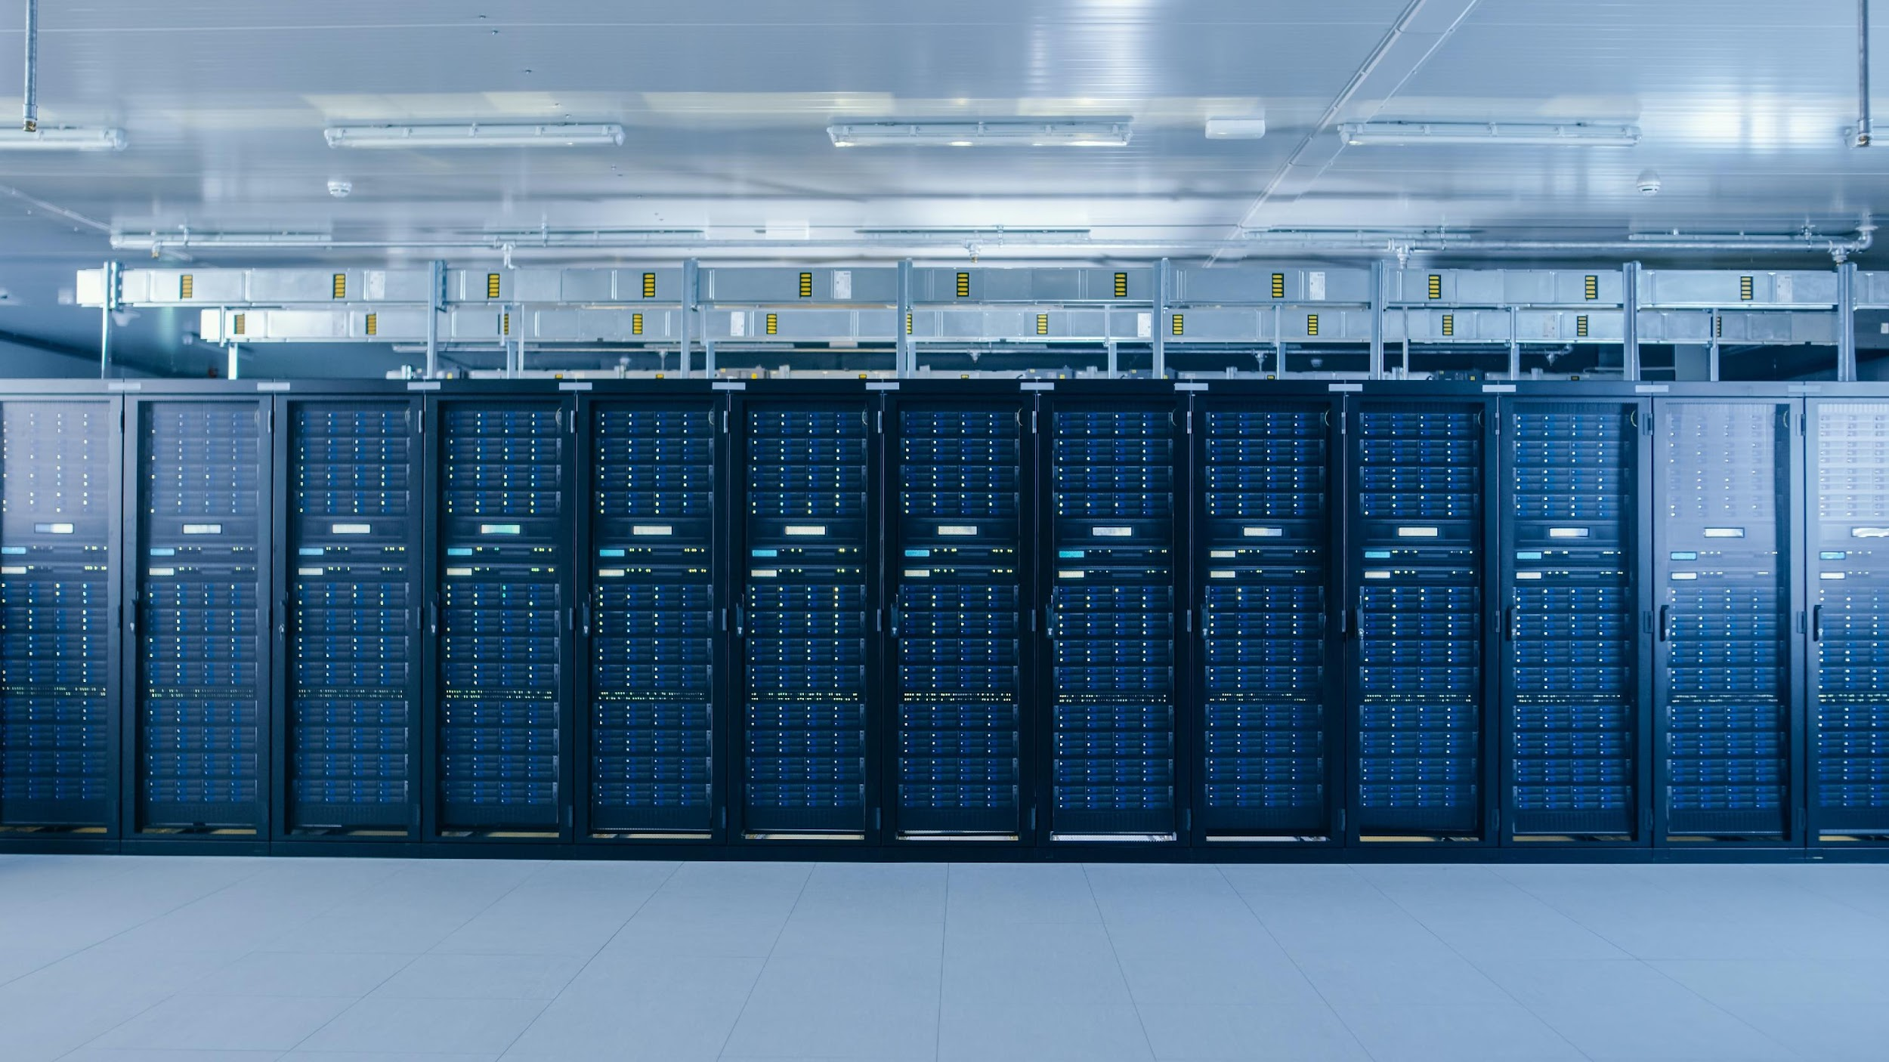
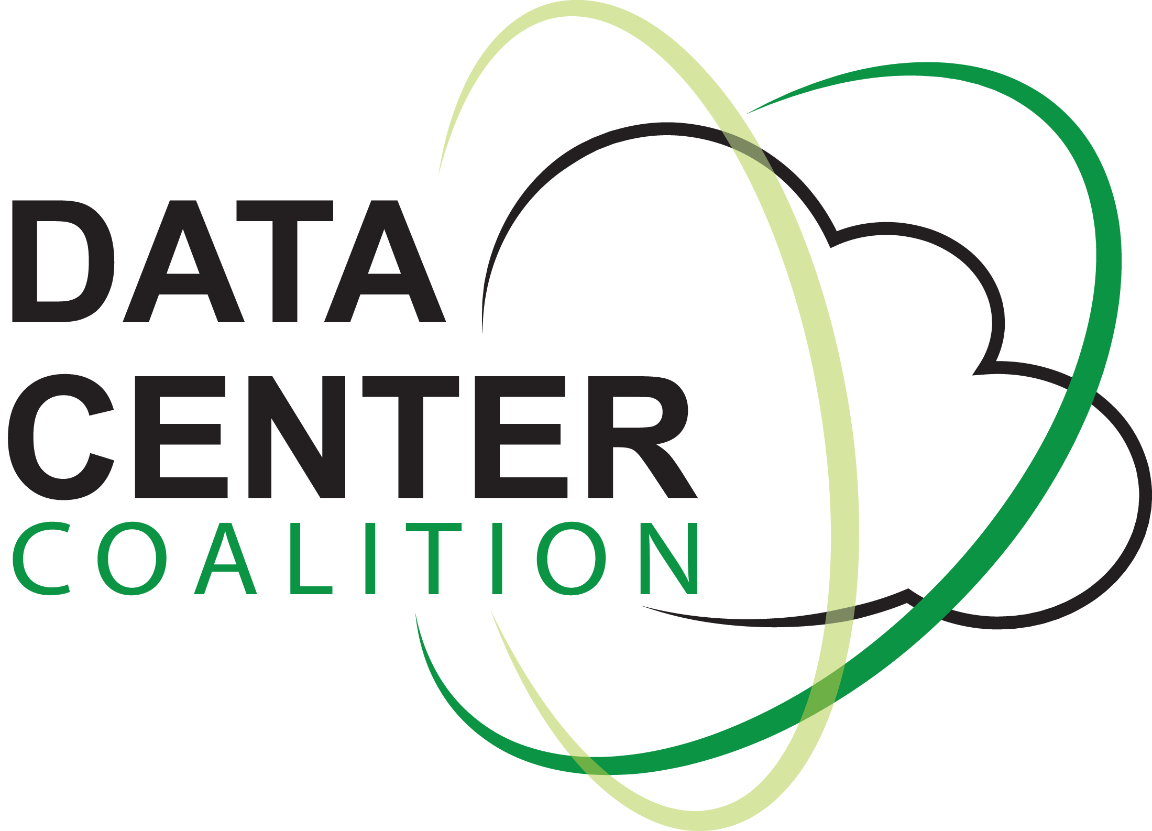
Data Center Workforce
Data Center Coalition | 2024

Slide 2
What are Data Centers?
Data centers power our daily lives. They are the physical facilities that house computing machines and related information technology (IT) infrastructure, such as servers and network equipment, and store the digital data demanded by users around the globe.
These places bring together all our online activities, like sharing photos, streaming shows, learning online, and keeping important info safe. Imagine it as a one-stop-shop for everything digital.
Data centers are a crucial component of the modern economy, helping businesses go digital and support various industries and services. Without them, our tech-driven world wouldn't function as smoothly as it does.

Slide 3
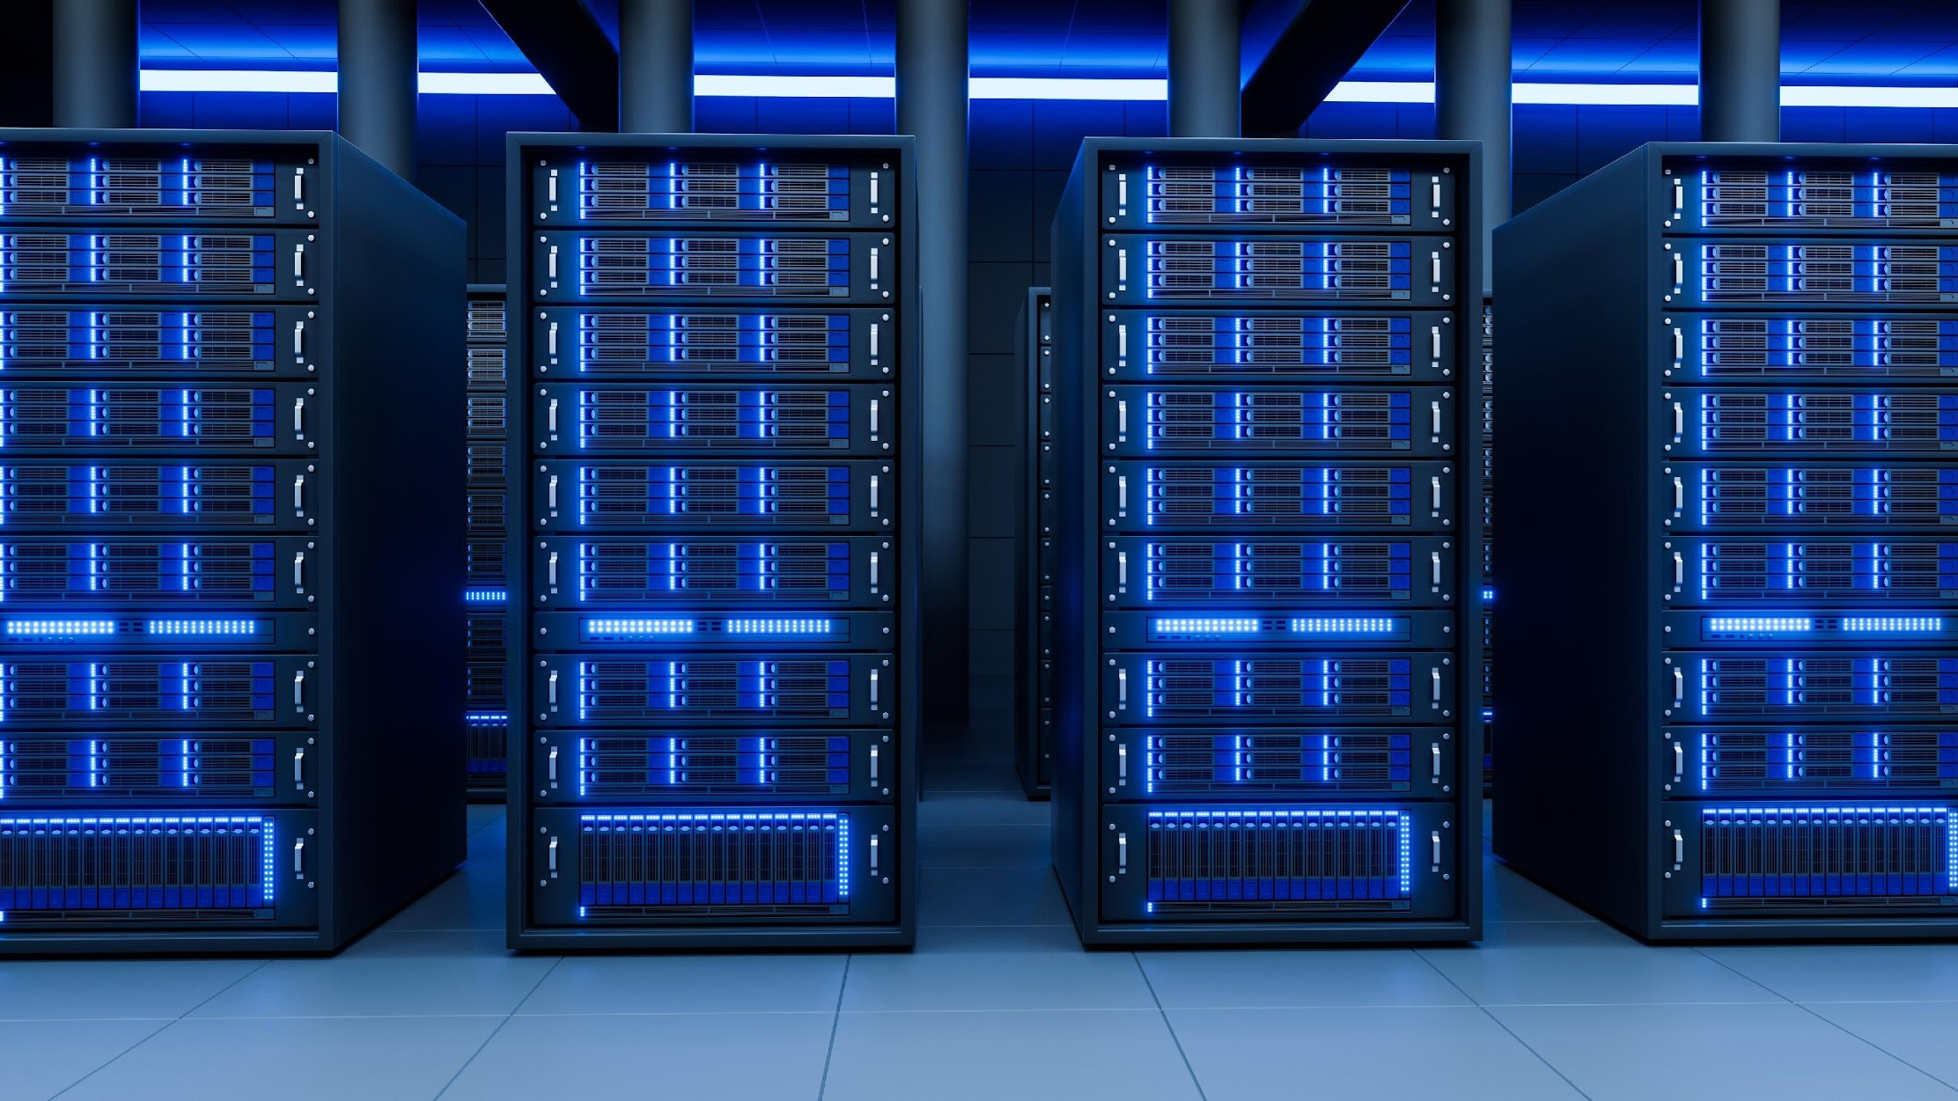
Data center types include the following:
Enterprise
Hyperscale
Colocation
Edge
A company-owned data center used for internal data processes.
A data center containing at least 5,000 servers, spanning a minimum of 10,000 square feet (930 square meters and offering at least 40MW of capacity.
A data center that leases equipment or bandwidth to other companies.
A smaller data center located as close to the end user as possible, typically used to support Internet of Things and other low-latency demands.
NAICS code 518210 comprises establishments primarily engaged in providing infrastructure for hosting or data processing services. See explanation for the selection of this NAICS code in the Appendix on pg. 64.
US Bureau of Labor Statistics, Quarterly Census of Employment and Wages. An establishment is a single physical location where one predominant activity occurs.

Slide 4
The Data Center Workforce
2.9 to 3.5 million annual jobs
$209 to $294 billion in annual labor income
Projected 12% Growth
Each direct job in the data center industry supports more than 6 jobs elsewhere in the US economy.
Total impact on national labor income grew 40% and labor income earned directly from the data center industry grew by 74% between 2017 and 2021.
In 2021, the data center industry supported 468,800 jobs directly. According to the U.S. Department of Labor, Computer and IT occupations are expected to grow by 12% from 2014 to 2024, surpassing the average growth rate for all occupations.
*Total impact includes direct, indirect, and induced impacts. Direct impacts are those occurring directly within the data center industry. Indirect impacts are those occurring within other businesses as part of the supply chain to the data center industry. Induced impacts are those arising from household spending of income earned from the data center industry or its supply chain.

Slide 5
Data center occupations require a wide range of skills and expertise, allowing people with different educational backgrounds and professional experiences to contribute to the growing field. With over 230 specialist job roles, the industry will require over 300,000 new full-time equivalent positions by 2025.
Engineers Computer Occupations Business Operations Specialists Financial Specialists Security and Compliance Information & Records Keeping Advertising, Marketing, Promotions, Public Relations, and Sales Managers | Office Supervisors & Administrative Support Workers Environmental Health & Safety Real Estate Construction, Design, & Development Project & Program Managers Sales Representatives, Services

Slide 6
Mission Critical Roles

Slide 7
Data Center Technician
Other Titles
Smarthands/Helping Hands Technician
Service Delivery
Data Center Operations (DCO) Technician
Average Salary
$25-$45 per hour
(Varies by market and company)
Job Function
Mechanical: Installing, operating, monitoring & maintaining the critical equipment required to keep a data center up & running without disruptions. This includes electrical & physical equipment (racks, servers, networks, switches, etc..)
Common Education/Experience
Associates degree or industry certifications
Experience trouble-shooting and/or racking & hardware maintenance or comparable.
Related mechanical or electrical work experience.

Slide 8
Data Center Engineer
Other Titles
Critical Facilities Technician
Data Center Engineering Operations (DCEO)
Data Center Shift Engineer
Average Salary
$35-$55 per hour
(Varies by market & company)
Job Function
Operating & maintaining the power, cooling & various other systems that keep the data center operational 24/7/365. These systems include: UPS, Generators, ATS, Switch gear, CHAHs, chillers and other complex electrical & mechanical equipment.
Common Education/Experience
Associates degree or industry certifications
Experience in data center or comparable.

Slide 9
Operations Manager
Other Titles
Data Center Manager
Facilities Manager
Infrastructure Manager
Average Salary
$125K-150K yearly
(Varies by market & company)
Job Function
Maintaining the design, planning, maintenance & operational integrity of mechanical, electrical, plumbing, and other infrastructure systems within the data center.
Management of operations team.
Common Education/Experience
6-10 Years of experience in a data center, critical operations, or electrical maintenance is comparable.
Bachelor’s degree preferred.

Slide 10
Support Roles

Slide 11
Customer Success Manager
Other Titles
Customer/Client Support
Account Manager
Customer Experience
Average Salary
$45K-70K yearly
(Varies by market and company)
Job Function
Advocates on behalf of customers ensuring service delivery & customer satisfaction through on-boarding, deployment & ongoing support.
Common Education/Experience
Experience in customer support/service, business, account management, project management, data center/IT service delivery or communications is comparable.

Slide 12
Data Center Ecosystem
Leading data center firms actively support communities, dedicating significant resources to enhance local well-being. They invest billions in STEAM education, empowering community members with technical skills and nurturing the next generation of data center professionals. Additionally, these companies contribute millions of dollars and thousands of volunteer hours to charitable causes, addressing issues like food insecurity, education, and women’s empowerment. Notably, data centers prioritize workforce diversity, setting goals to increase representation across various demographics, including women, minorities, veterans, disabled individuals, and LGBTQ+ community members.
Learn more about data center careers at https://www.datacentercoalition.org/careers

